Slide 1




GRADE 10 · ALGEBRA II · Week 8
Pre-Session
Home task before class
Watch · Study · Check · Submit on the LMS before class
Lesson 2-6
The Quadratic Formula
OBJECTIVES
Analyze the discriminant to identify the number and type of solutions for a quadratic equation.
Solve quadratic equations using the quadratic formula, including those with nonreal solutions.
Mr Malek Thiab
FAITH, RIGHTEOUSNESS AND WISDOM
HSN.CN.C.7 · HSA.REI.B.4.A · HSA.REI.B.4.B
Notes:
Speaker notes: Send this pre-session to students before Lesson 2-6. Four slides: cover, the one idea (video and compressed key idea), one worked example, and a four-question ungraded readiness check. Objectives are quoted from the curriculum map. Vocabulary: Discriminant, quadratic formula. Verbal misconceptions: students think the formula is only for hard equations (it solves every quadratic) or that it is a new topic (it comes from completing the square in Lesson 2-5). Adaptive routing: if fewer than 70 percent open the pre-session, use the Wayground poll to find out and start Targeted Instruction with the two-minute recap on slide 2.

Slide 2


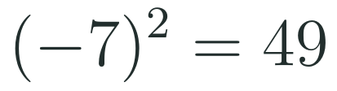
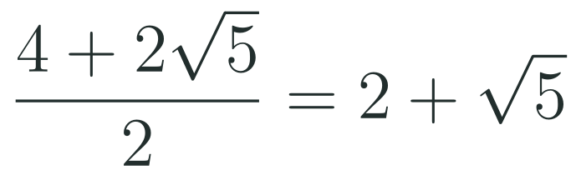
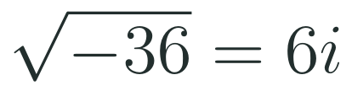
SLIDE 2 · WATCH · LESSON 2-6
The one idea
WATCH BEFORE CLASS
KEY IDEA
How to use the quadratic formula
Khan Academy · YouTube
https://www.youtube.com/watch?v=i7idZfS8t8w
LISTEN FOR
How the three coefficients are read from the equation, with their signs.
How the numbers are substituted into the formula and simplified step by step.
Why the part under the square root decides how many real solutions there are.
Vocabulary: Discriminant · quadratic formula
THREE THINGS YOU ALREADY KNOW
Squaring a negative
Radical fractions
Roots of negatives
The bracket is squared, so the answer is positive.
Divide every term of the top by the bottom.
From Lesson 2-4: the root of a negative uses the imaginary unit.
HSN.CN.C.7 · HSA.REI.B.4.A · HSA.REI.B.4.B
FAITH, RIGHTEOUSNESS AND WISDOM
Mr Malek Thiab · 2
Notes:
Speaker notes (Watch and key idea):
Video: How to use the quadratic formula, Khan Academy, https://www.youtube.com/watch?v=i7idZfS8t8w (the link was checked against third-party listings only; please open it once before sending). Key idea: for ax² + bx + c = 0, x = (−b ± √(b² − 4ac)) all over 2a. The discriminant Δ = b² − 4ac is the part under the root: positive gives two real solutions, zero gives one, negative gives two nonreal solutions. Priors: (−7)² = 49; (4 + 2√5)/2 = 2 + √5, because every term of the numerator is divided; √(−36) = 6i. Verbal misconceptions: using b instead of −b; writing (−7)² as −49; dividing only one term of the numerator; saying Δ < 0 means no solution (it means two nonreal solutions). Adaptive routing: if the Wayground items 2 and 6 show more than 30 percent wrong, recap this slide for two minutes before Targeted Instruction.

Slide 3


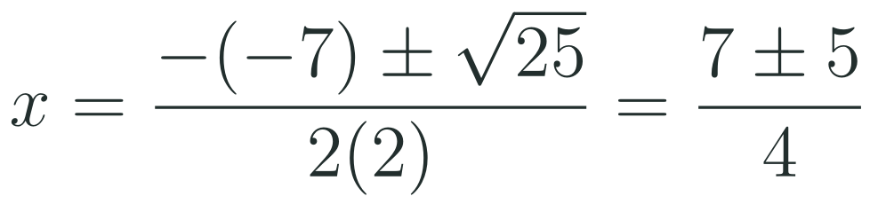
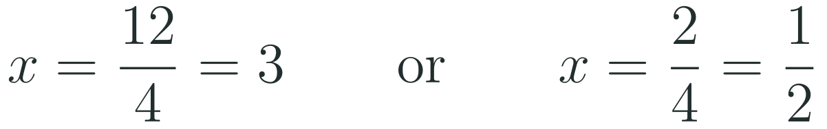
SLIDE 3 · STUDY · LESSON 2-6
One worked example
Cover the right-hand side, try each step yourself, then check.
1
Write the three coefficients WITH their signs.
2
Find the discriminant first.
3
Substitute. The minus in front of the b turns into a plus.
4
Split into the two solutions.
5
Check one solution in the original.
The mistake most people make: keeping b instead of its opposite. The numerator then starts with minus seven instead of plus seven, and neither answer passes the check.
HSN.CN.C.7 · HSA.REI.B.4.A · HSA.REI.B.4.B
FAITH, RIGHTEOUSNESS AND WISDOM
Mr Malek Thiab · 3
Notes:
Speaker notes (Worked example):
Worked solution. 2x² − 7x + 3 = 0: a = 2, b = −7, c = 3. Δ = (−7)² − 4(2)(3) = 49 − 24 = 25. x = (7 ± 5) all over 4, so x = 12 over 4 = 3, or x = 2 over 4 = 1/2. Check x = 3: 18 − 21 + 3 = 0. Common mistake: writing −b as −7 gives (−7 ± 5) over 4, which is −1/2 or −3; check x = −3: 18 + 21 + 3 = 42, not 0. Verbal misconceptions: b is −7, so −b is +7; the denominator is 2a = 4, not 2; Δ = 25 is a perfect square, so the solutions are rational and the quadratic factors as (2x − 1)(x − 3). Adaptive routing: if more than 30 percent give −7 ± 5 over 4 in Wayground item 6, spend the first three minutes on substituting negative numbers inside brackets.

Slide 4



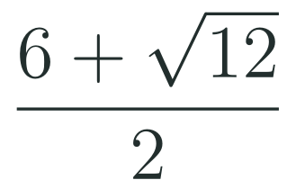
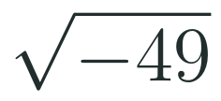

SLIDE 4 · CHECK · LESSON 2-6
Four questions: answer before class
This is not graded. It tells me what to teach first, so an honest answer helps you more than a lucky one.
1
Evaluate the discriminant of this equation.
HOW TO SUBMIT
Type your four answers into the LMS form, one line each.
If you are stuck, write "not sure yet" and say what confused you. That is a useful answer.
Due before the bell. It takes three minutes.
2
Simplify this fraction fully.
3
Write this using i.
4
A parabola never crosses the x-axis. Is this positive, zero or negative?
In class we start with: an 8-question Wayground kick-off (about 4 minutes) on the formula, the discriminant and the four skills above. Then we go straight into the quadratic formula.
HSN.CN.C.7 · HSA.REI.B.4.A · HSA.REI.B.4.B
FAITH, RIGHTEOUSNESS AND WISDOM
Mr Malek Thiab · 4
Notes:
Speaker notes (Readiness check):
Answers. Q1: a = 3, b = −5, c = 1; Δ = 25 − 12 = 13. Q2: √12 = 2√3, so the numerator is 6 + 2√3; dividing every term by 2 gives 3 + √3. Q3: √(−49) = 7i. Q4: negative (no real solutions, so Δ < 0). Verbal misconceptions: Q1 students write −25 − 12 or 25 + 12 = 37; Q2 students answer 3 + √12 or 6 + √6; Q3 students answer −7 or say impossible; Q4 students answer zero. Adaptive routing: if more than 30 percent miss Q1, rehearse negative substitution; Q2, work (4 + √20) over 2; Q3, recall Lesson 2-4; Q4, sketch the three parabola cases with 2, 1 and 0 x-intercepts.

